Slide 1

Coursework 3
CST2550

Slide 2
Introduction
This project focused on creating a lightweight file management system with primary focus of allowing the user to read, write and delete data in C++. The key classes of the program include ‘file’, ‘filesystem’, ‘directory’ and ‘fileDescriptor’ with each having specific functionalities and responsibilities.

Slide 3
Objectives
The main objectives of the file system are:
File Operations: create, read, write and delete files
Directory Management: a hierarchy structure to organise files using directories
Error handling : handle potential issues such a files not found.
User interface : Menu view for user to effortlessly interact with the file management system.

Slide 4
Key Classes
File: this represents a file in the system with attributes of name, size and content. It also has methods for reading, writing and deleting file contents.
Directory: this represents a directory in the system that can contain files and subdirectories. It also has methods to add, retrieve and delete both files and directories in it.
FileSystem: this manages the overall system, includes root directory and provides methods to create, read, write and delete files and directories.
FileDescriptor: this manages files by reading and writing positions.

Slide 5
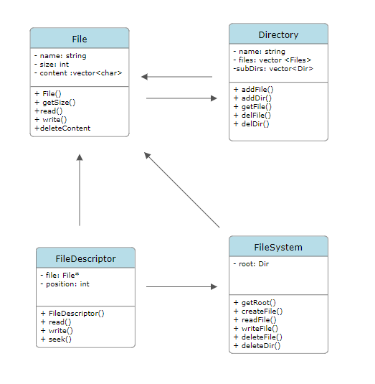

Slide 6
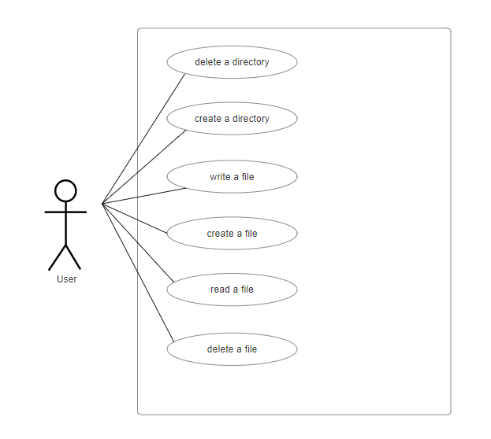

Slide 7
Implementation
After the classes and methods in the previous slides had been defined each class was implemented in its own header (‘.h’) and source files (.cpp). This was done to ensure readability and modularity.
A makefile was created to specify how each file should be linked to each other and to automate the compilation.
The user interface was created in a separate main.cpp file to allow the user to interact with the system.

Slide 8
Version control
Version control was used in this project to track and manage the changes made to the code over time in a structured manner. This was extremely when fixing bugs as you have a previous running version that you can compare to.

Slide 9
Conclusion
This project is a lighweight file system and allows simple file manipulation. The 4 classes work together to provide the functionality of the file system on the user command line.
A limitation of this project is the lack of security, the program does not have any protection against unauthorised access of data. Unauthorised users have the ability to modify data in this program.
Another limitation is there is limited error handling, whilst there is some error handling it is not extensive. It doesn’t cover things like long filenames or when the disk is full.

